Slide 1
E-retail factors for customer activation and retention A case study from Indian e-commerce customers
Submitted by:
VANISREE .P.G

Slide 2
INTRODUCTION
Customer satisfaction has emerged as one of the most important factors that guarantee the success of online store; it has been posited as a key stimulant of purchase, repurchase intentions and customer loyalty.
A comprehensive review of the literature, theories and models have been carried out to propose the models for customer activation and customer retention.
Five major factors that contributed to the success of an e-commerce store have been identified as: service quality, system quality, information quality, trust and net benefit.
The research furthermore investigated the factors that influence the online customers repeat purchase intention on the basis of the Means End Chain theory (MEC) and Prospect theory.

Slide 3
By hypothesising that a combination of both utilitarian value and hedonistic values are needed to affect the repeat purchase intention (loyalty) positively, Structural equation model has been presented on the primary data collected from the Indian online shoppers.
Results indicate the e-retail success factors, which are very much critical for customer satisfaction.
By increasing the utilitarian value and hedonistic values derived by the customers, customer satisfaction and hence the customers repeat purchase intention can be increased significantly.

Slide 4
PROBLEM STATEMENT
The primary goal of this research is to analyze the customer satisfaction and loyalty of the online customers. The theoretical framework discusses in brief about the effects of customer loyalty and retention on customer satisfaction
Customer satisfaction has emerged as one of the most important factors that guarantee the success of online store; it has been posited as a key stimulant of purchase, repurchase intentions and customer loyalty.
A comprehensive review of the literature, theories and models have been carried out to propose the models for customer activation and customer retention.
Five major factors that contributed to the success of an e-commerce store have been identified as: service quality, system quality, information quality, trust and net benefit. The research furthermore investigated the factors that influence the online customers repeat purchase intention.
The combination of both utilitarian value and hedonistic values are needed to affect the repeat purchase intention (loyalty) positively.
The data is collected from the Indian online shoppers. Results indicate the e-retail success factors, which are very much critical for customer satisfaction.

Slide 5
Motivation for the Problem Undertaken
The objective of this research study is to investigate online consumer behavior, which in turn provides E-marketers with a constructional framework for fine-tuning their E-businesses’ strategies. The specific objectives of this research are:
1. To analysis the consumers awareness about online shopping.
2. To know the various factors which motivate a consumer towards online shopping.
3. To know the problems they face during online shopping
4. To offer suggestions for solving the problems faced by online consumers.

Slide 6
HARDWARE AND SOFTWARE REQUIREMENTS AND TOOLS USED
Hardware used for doing the project is a ‘Laptop’ with high end specification and stable internet connection .while coming to the software part I had used ‘python jupyter notebook’ for do my python program and data analysis.
Excel file and Microsoft excel are required for the data handling. In jupyter notebook I had imported lot of python libraries are carried to this project and I have mentioned below detailed.
1.Pandas-a library which is used to read the data ,visualization and analysis of data.
2.Numpy-used for working with array and various mathematical operations in python.
3.Seaborn- visualization for plotting different type of plot.
4.Matplotlib- It provides an object-oriented API for embedding plots into applications .

Slide 7
Data Sources
The data is collecting from the Indian online shoppers. Online store customer data offers many opportunities to improve shopping experience. The use of various types of data sets aims at personalization, better customer service and a better understanding of users.
The data is been given by a highly-confidential company and they gave it to us in an excel file. They also had provided the problem statement by explaining what they need from us and also the required criteria to be satisfied
They are totally 269 rows and 71 columns in this dataset. Our target is to find the insights of the data and to do thorough data analysis
There are many comprehensive tools that use customer data analytics and artificial intelligence to support business, and integrating them with your store is childishly easy.

Slide 8
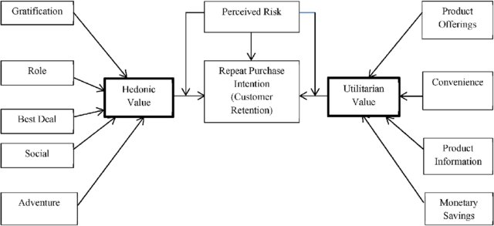
Diagrammatic Representation of Customer Retention

Slide 9
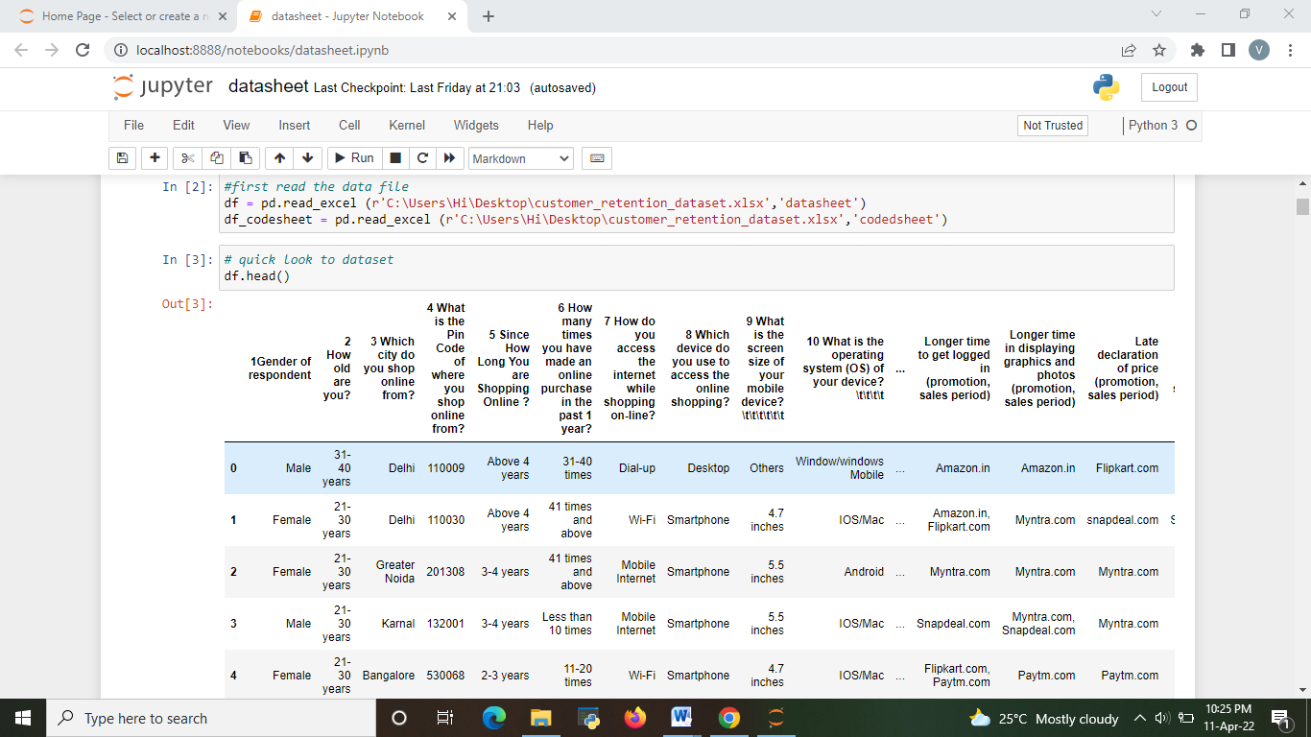
UPLOADING DATA SET
We have to import libraries necessary for data analysis. After we have to uploading the data using the excel file provided in two different Data Frames.
df - contain the detailed description of datasets .Enable us to analysis the data in encoded form
df_codesheet - contain the Encoded form of dataset. Enabling us to analysis the data in encoded form.

Slide 10
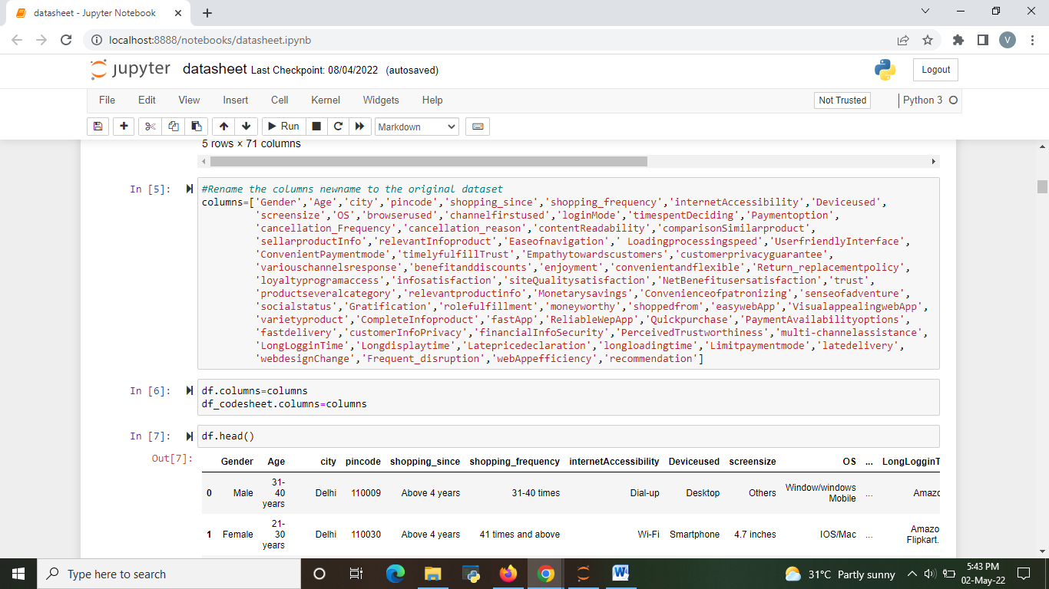
DATA ANALYSIS
Shortening the column names with original dataset

Slide 11
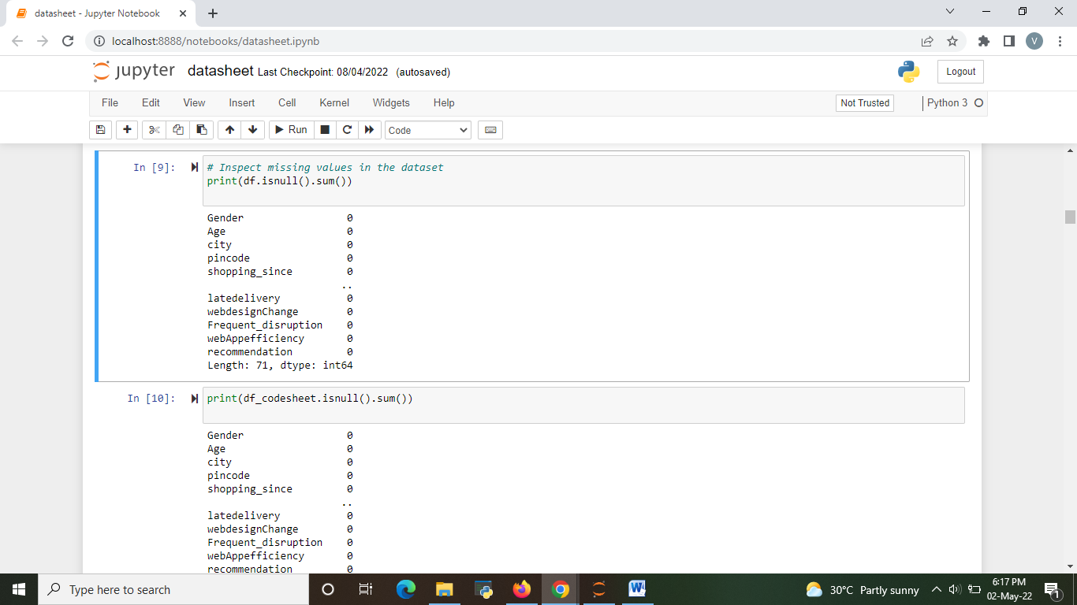
b) Checking missing value from the data set.
There is no null values in the dataset

Slide 12
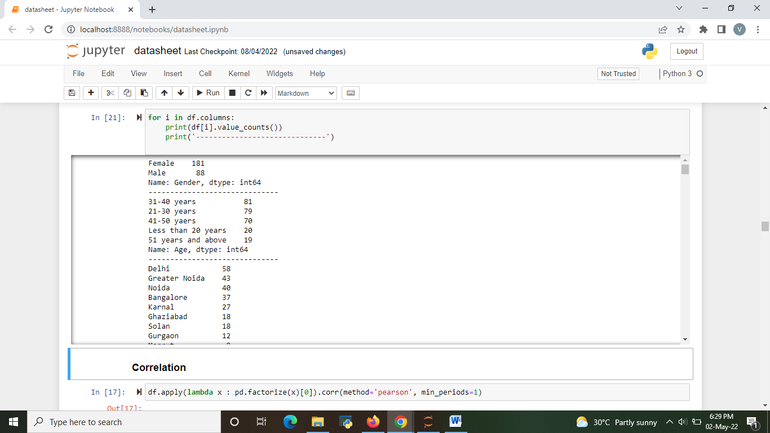
c) There is a detailed value count of each columns .iterate each column by using for loop.
We can see some value counts of the columns like Gender ,age ,city ,ect.

Slide 13
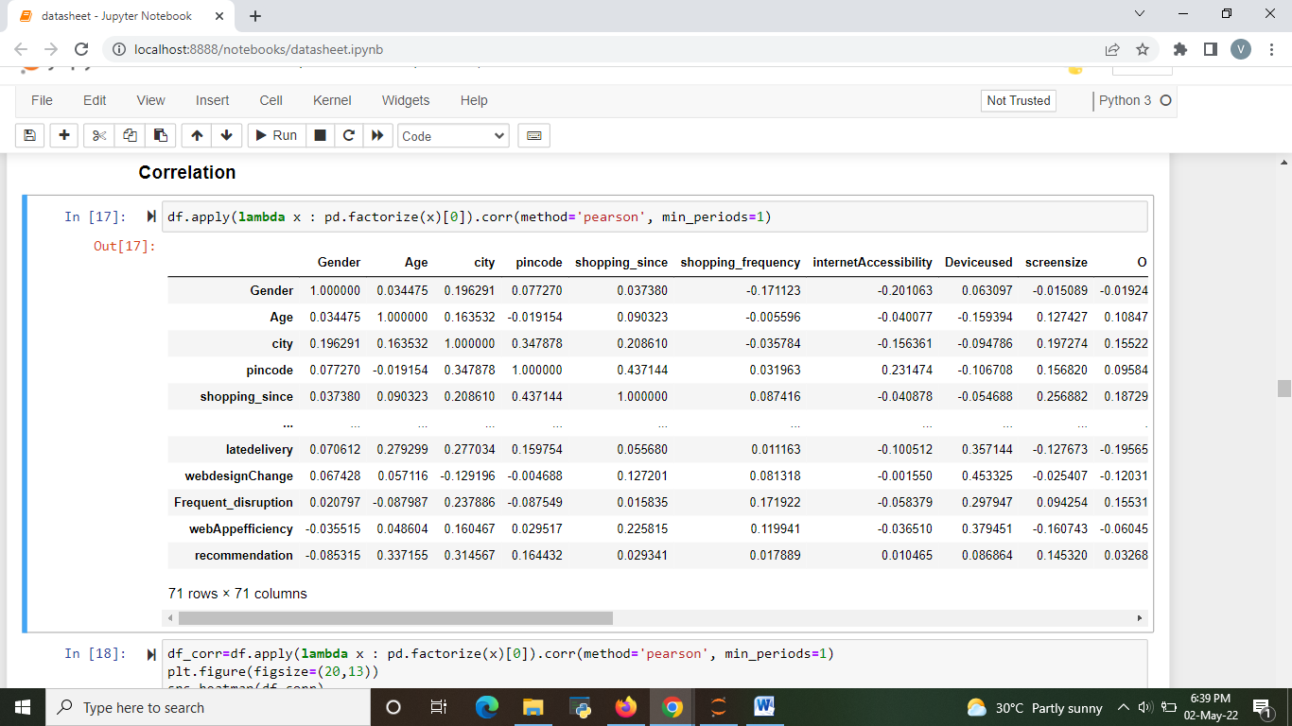
CORRELATION
d) Correlation between all the columns in the datasets

Slide 14
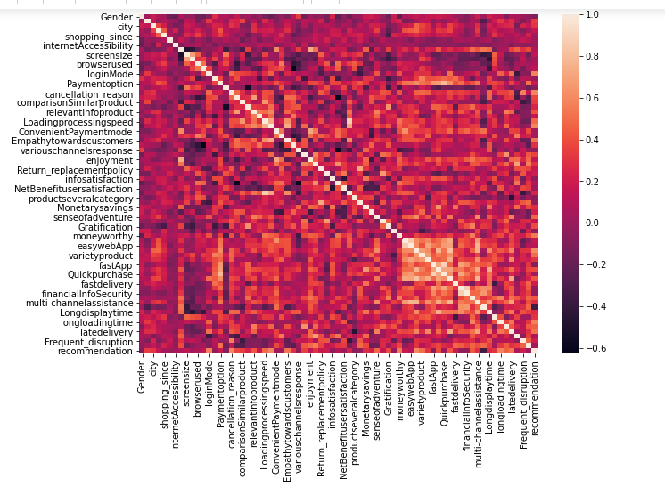
Correlation Heat map

Slide 15
Correlation Heat map inference:
In above correlation Heat map, we have the following observations:
Most of the high correlation factors are return replacement policy, convenient payment mode and Relevant payment policy, Monetary saving.
Screen size and operating system has the lowest correlation.
‘Ease to read and understand website’ and ‘privacy of customers’ have high correlation.

Slide 16
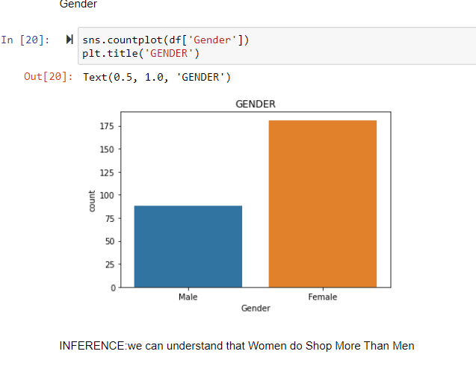
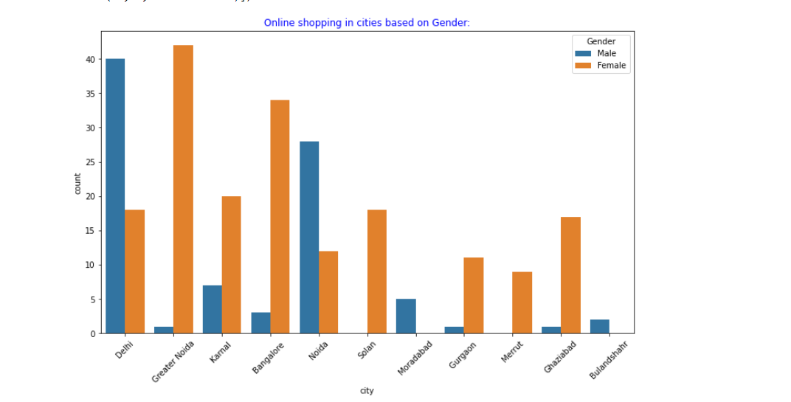
Visualizations and Inference
we can see that female shop online higher than male.
Only Delhi and Noida have large number of male shopper than that of Bangalore, Karnel ,Gurgaon.
In Moradabad and Bulandshahr there is no female shopper

Slide 17
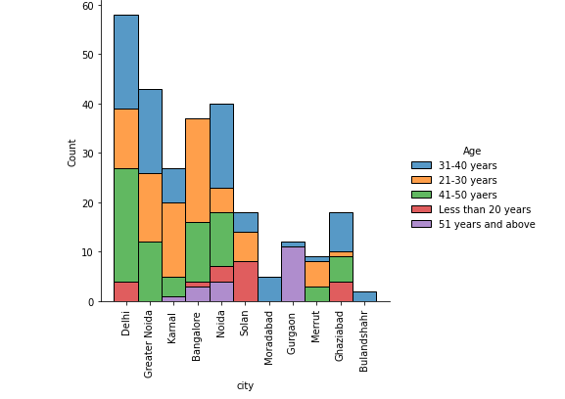
Online shopping in cities based on various age groups
In city like Bangalore and karnal young people(21-30) shop higher
In city like Delhi , Noida ,Greater Noida mid age (31-40) people shop higher.
In Bulandshahr and Moradabad only (31-40) age group shopper are there.

Slide 18
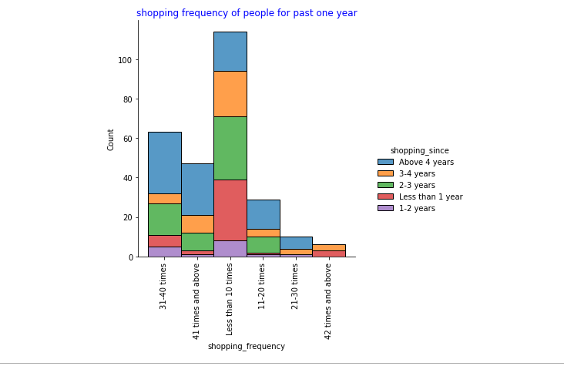
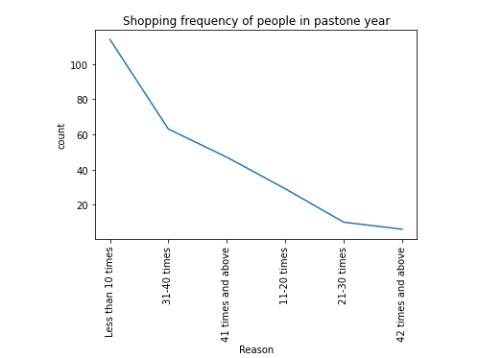
shopping frequency of people for past one shopping Frequency are decrease for past one year.

Slide 19
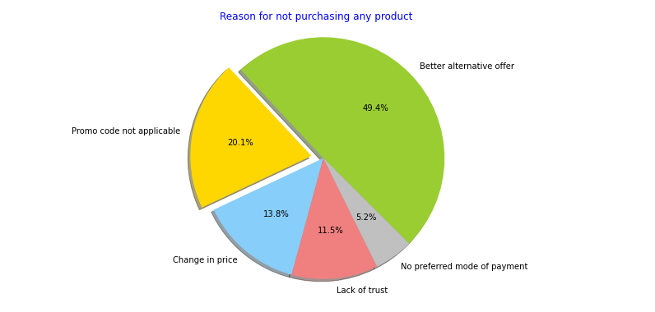
Top reason for cart abandonment
Many people’s Reasons for not purchasing Better alternative options. 11.2% people with lack of trust

Slide 20
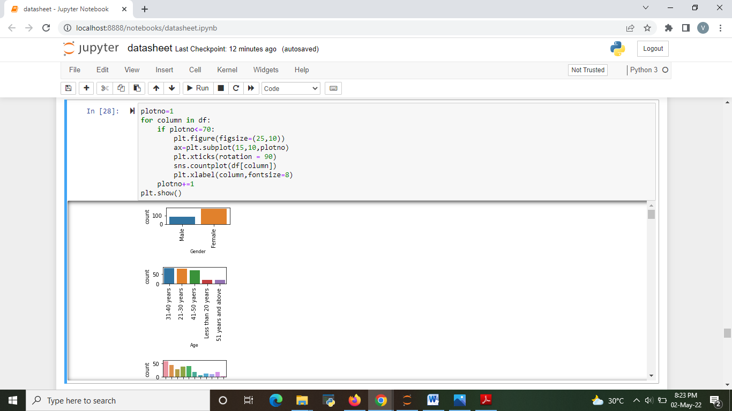
We plot the visualization of all 71 columns above and we iterated using on for loop. we can some visualization of the columns like gender, age, city, ect.

Slide 21
Inference from Visualizations
Female do shop than male.
21-50 years age of consumers most prefer to shop online.
Age of less than 20 and 51 years and above people are do shop online are less.
Most of the online shoppers are from Delhi ,Greater Noida ,Noida ,Bangalore.
The maximum people have an experience of above 4 years. Only less of people have an experience of 1-2 years.
The maximum consumers said they shop online at less than 10 times, few of consumers shop online at 42 times and above.
The maximum number of consumers mobile internet use while shopping on-line.

Slide 22
Inference from Visualizations
Maximum people have shopped from these 5 companies like Amazon.in , FlipKart.com ,paytm.com ,myntra.com ,Snapdeal.com.
These companies are easy to use website or application.
In terms of Visual appealing web-page layout and Wild variety of product on offer Amazon.in, Flipkart.com are the major choice of customers.
The maximum number of people chosen with Amazon.in, Flipkart.com based on Complete, relevant description information of products. Snapdeal.com have least one
Amazon have high score when it comes to fast loading website and Reliability of the website, although Paytm.com are not far behind.
When it comes to Quickness to complete purchase, Amazon have high score and next high score is Flipkart.com, Paytm.com.
Amazon.in, Flipkart.com have several availability of payment options. Patym.com have least options.
Amazon is the best Speedy order delivery website. Flipkart.com, Myntra.com, Snapdeal.com had the least one.

Slide 23
Privacy of customers’ information have highly maintained by Amazon, followed by Flipkart.
Amazon having good trustworthiness. Flipkart.com, Snapdeal.com both also have
trustworthiness.
Amazon.in, Flipkart.com, Myntra.com, Snapdeal all are provide online assistance through multi-channel.
Amazon, Paytm takes longer time to get logged in. Flipkart.com doesn’t take longer time to get logged in.
Amazon.in, Flipkart.com both are takes longer time in displaying graphics and photos. Paytm.com not takes longer time in displaying graphics and photos.
Myntra.com and Paytm.com both are work on late declaration of price.
Myntra.com and Paytm.com both are negative feedback in longer page loading time.Amazon.in, Paytm.com, Myntra.com are doesn’t take longer page loading time.
Snapdeal.com and Amazon.in have limited mode of payment on most products.
The shopper told that Amazon.in and Paytm.com are frequently Change in website/Application design.
While using Amazon.in, Myntra.com and Snapdeal.com. Frequent disruption when moving from one page to another.
Amazon.in and Flipkart.com are most recommended Indian online retailer for shopper

Slide 24
MAJOR FINDINGS
Many customers have shopped from amazon and flipkart.it is one of easy to use website. All age group customers are there.
Amazon and flipkart have been suggested as most Visual appealing web-page layout and Wild variety of product on offer.
Amazon and flipkart have got more positive feedbacks than other website with high content readability, information on similar product, relevant information on listed product, ease of navigation in website, Convenient Payment.
Flipkart gives important to the user friendly Interface, high Empathy towards the customers, able to guarantee the privacy of the customer.
Paytm has got less feedbacks in show least Empathy towards the customers, perceived trustworthiness, speed order delivery.
Myntra and paytm have low guarantee the privacy of the customer ,trust towards website is low.

Slide 25
Amazon and Myntra both are gives monetary benefit and discount.
Amazon gives Return and replacement policy to the shoppers.
In Flipkart, Myntra, paytm and Snapdeal Return and replacement policy are lower percentage.
Amazon and flipkart give complete and relevant product information compare with this Myntra and paytm are least one.
Myntra has got the least feedbacks in website as efficient as before, followed by snapdeal.
Snapdeal.com has got a smaller number of feedbacks in change of websites/application design.

Slide 26
suggestions and recommendations to all the e-commerce websites
1. Amazon.in
Positive feedback:
Visual appealing web-page layout and Wild variety of product on offer.
Convenient to use and also a good website for shopping
fast loading website and Reliability of the website.
Speedy order delivery website.
Privacy of customers’ information have highly maintained.
online assistance through multi-channel.
Complete information of products available.
Suggestion to improve:
Give more payment options to customers
Try to avoid frequent disruption when moving from one page to another.
Try to give price early during promotion.
Reduce the delivery time of the products.

Slide 27
2. Flipkart.com
Positive feedback:
Convenient to use and also a good website for shopping.
Fast delivery of products.
Availability of complete information of the products.
Presence of online assistance through multi-channels.
Reliable website or app, perceived trustworthiness.
Wild variety of products to offer and money worth.
Suggestion to improve:
Give more payment options to customers.
Try to give the price early during promotion.
During promotions, try to give a disturbance free shopping experience to customers.
Reduce the delivery time of the products.

Slide 28
3. Myntra.com
Positive feedback:
Convenient to use and also a good website.
Availability of several payment options.
Faster products delivery.
Complete information of products available.
Reliable website or app, perceived trustworthiness.
Wild variety of product to offer.
provide online assistance through multi-channel.
Suggestion to improve:
Reduce the delivery time of the products during promotions.
Try to give relevant information on listed products.
Longer page loading time and Late declaration of price.
Try to give Wild variety of product on offer and Complete, relevant description information of products.
Presence of online assistance through multi-channel should be improve.

Slide 29
4. Paytm.com
Positive feedback:
Convenient to use and a good website.
Quickness to complete a purchase.
About 64% of the customers feel that either web or app is reliable.
Around 20% of the customers believe that Paytm has a wild variety of products on offer.
Suggestion to improve:
Reduce the delivery time of the products during promotions.
Try to give relevant information on listed products.
Longer page loading time.
Late declaration of price and discounts.
Presence of online assistance through multi-channel should be improve.

Slide 30
5. Snapdeal.com
Positive feedback:
Convenient to use.
provide online assistance through multi-channel.
54% of the customers are happy about the availability of financial information security
Suggestion to improve:
Late declaration of price and discounts.
Try to give the price early during promotion.
During promotions, try to give a disturbance free shopping experience to customers.
Presence of online assistance through multi-channel should be improve.

Slide 31
General Suggestions all the e-commerce websites
Providing more competitive price can attract customers.
Online shopping sites should increase the security for online payment.
More attractive offers on products can attract more customers.
Measures to be taken in order to avoid delivery of duplicate products.
Measures to be taken in order to delivery product fastly.
Transaction should be safe and security assured to the people
Attractive discounting offers should be introduce to attract to more customers for online shopping.

Slide 32
Conclusion
Based on our survey on consumers’ online shopping behavior, online shopping using mobile apps is what preferred by consumers nowadays. It’s one of the e-commerce trends and the future for retail shopping.
Technology has made significant progress over the years to provide consumers a better online shopping experience and will continue to do so for years to come.
With the rapid growth of products and brands, people have speculated that online shopping will overtake in-store shopping.
Online shopping is preferred by customers . Further the prompt services by online retailers and wide spread internet has acted as enablers of online shopping.
Online shopping can be made more attractive by clarifying the apprehension of consumers with respect to financial and security risk.
So, make use of the e-commerce statistics data to increase your competitive advantage on the online purchase trends.

